Slide 1
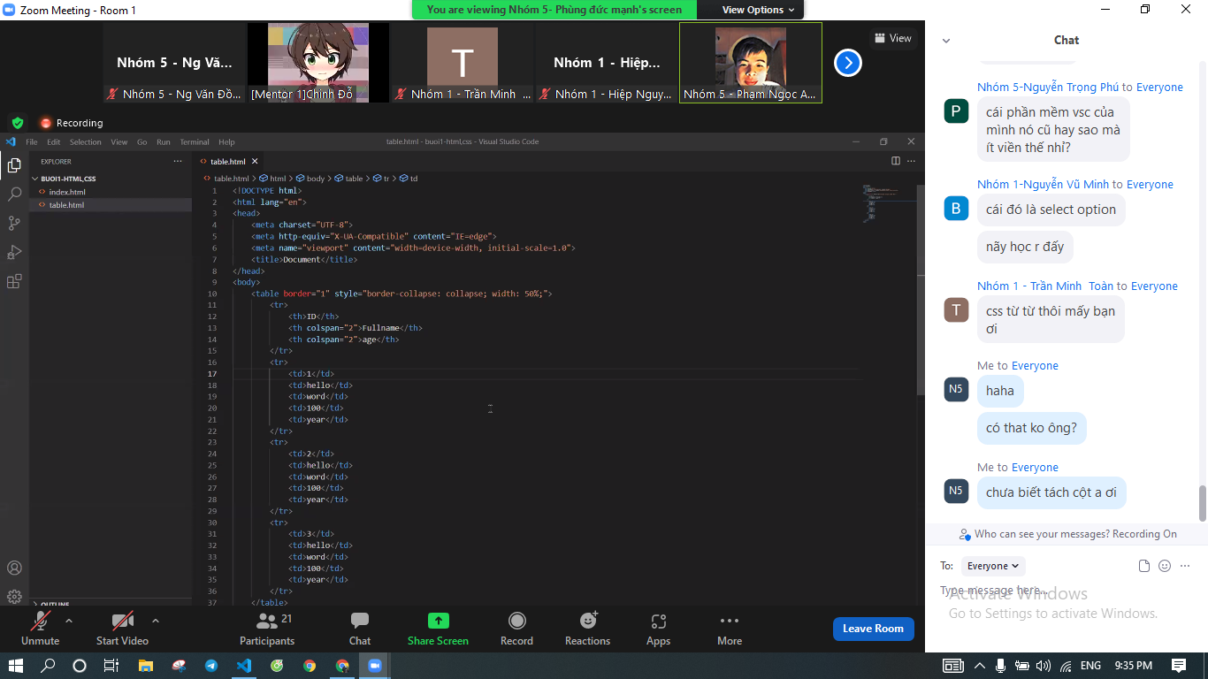

Slide 2
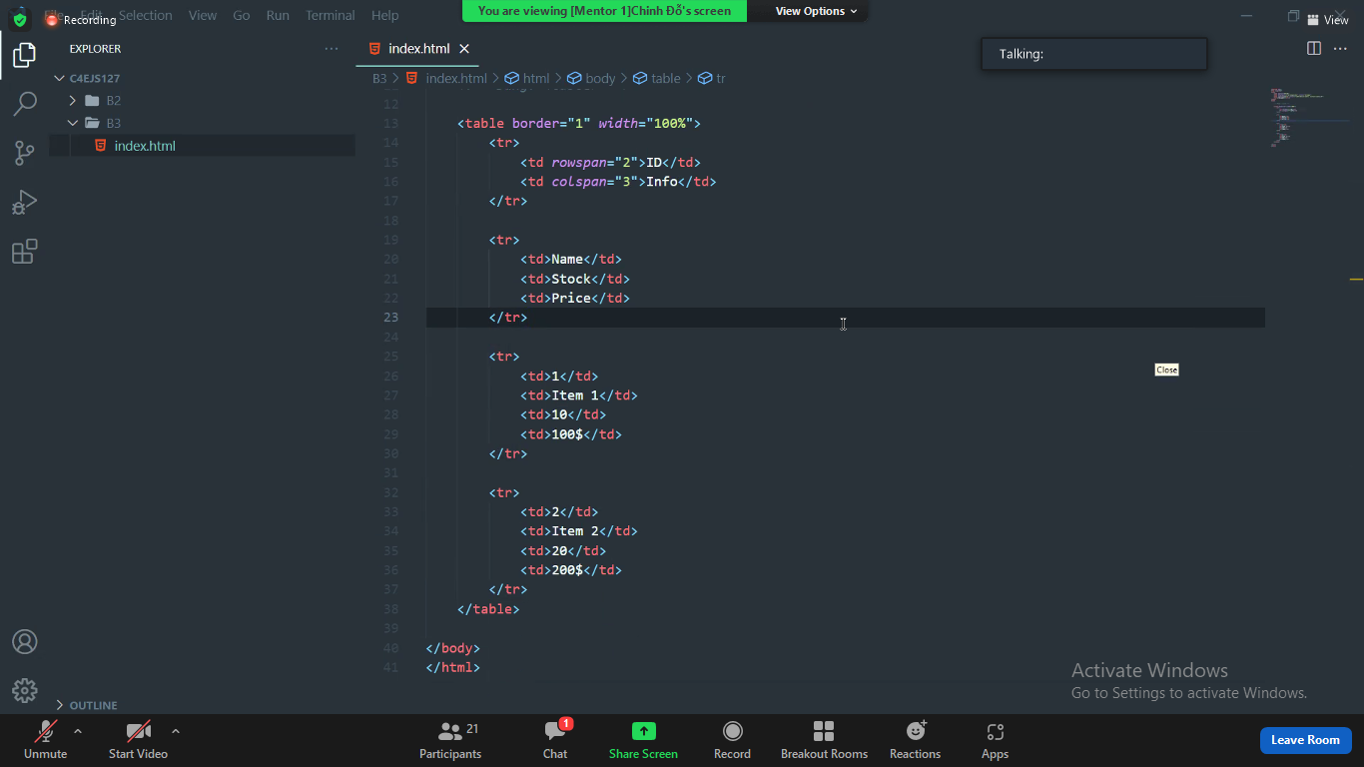

Slide 3
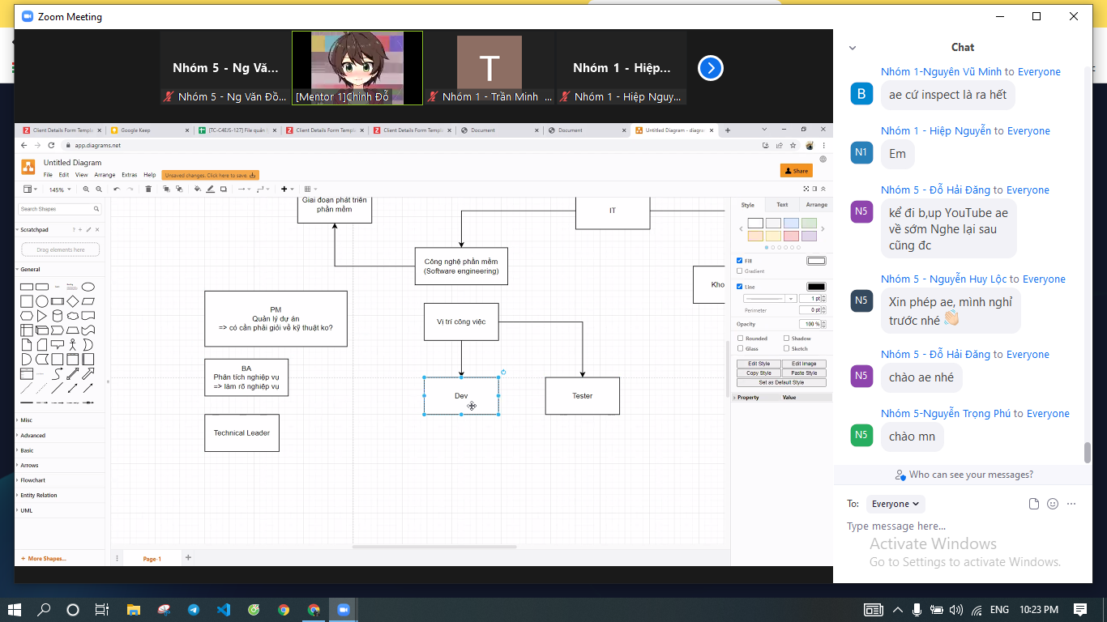

Slide 4
Intern
Fresher 1
Junior 1-4
Senior 4-7
Tech list 7-10

Slide 5
